Slide 1

Mobile Application System Design
(Chapter 6)
Course Lecturer: Nurul Amera Muhamad Nazmi

Slide 2
Mobile Application User Interface Operations
Content
Text Fields

Slide 3
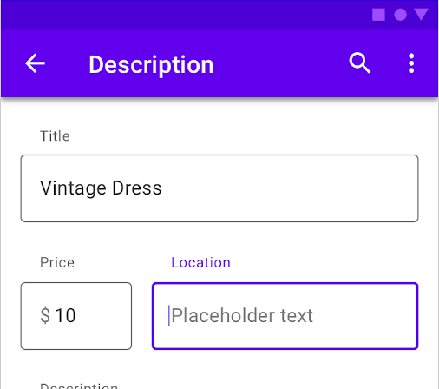
TextField
TextField in Flutter is the most commonly used text input widget that allows users to collect inputs from the keyboard into an app.
We can use the TextField widget in building forms, sending messages, creating search experiences, and many more.

Slide 4
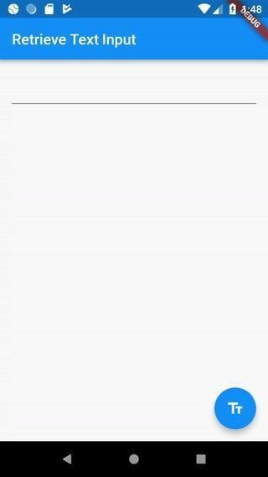
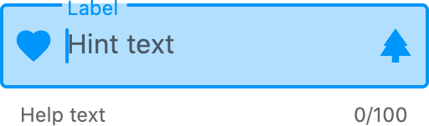
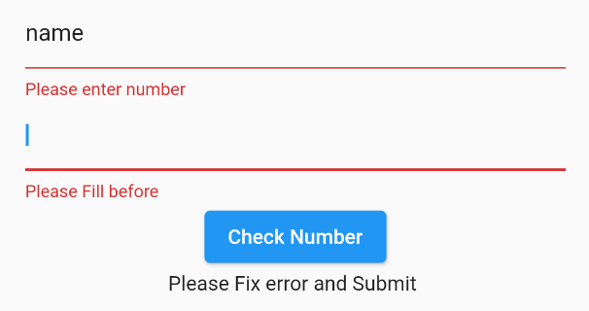
TextField
By default, Flutter decorated the TextField
with an underline.
We can also add several attributes with TextField, such as label, icon, inline hint text, and error text using an InputDecoration as the decoration.

Slide 5
How to retrieve the value of a TextField
Flutter allows the user to retrieve the text
in mainly two ways:
onChanged method: It is the easiest way to retrieve the text field value. This method store the current value in a simple variable and then use it in the TextField widget.
String value = ""; TextField( onChanged: (text) {
value = text;
},
)

Slide 6
How to retrieve the value of a TextField
Flutter allows the user to retrieve the text in mainly two ways:
Controller method: It is a method to retrieve text field value using TextEditingController
It will be attached to the TextField widget and then listen to change and control the widget's text value.
TextEditingController mycontroller = TextEditingController();
TextField(
controller: mycontroller,
)

Slide 7
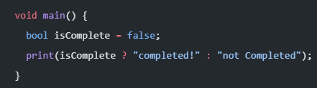
Change widget using Ternary Conditional Operators
Ternary Conditional Operators are a pretty useful thing in Dart.
result = testCondition ? trueValue : falseValue
They can be used to conditionally show a Flutter widget.
This will print “not completed”. If we change the value of isComplete to true, it will print completed.

Slide 8
Change widget using Ternary Conditional Operators
Ternary Conditional Operators can also be applied to control a widget will only be displayed when a condition is met.
void main() {
bool isComplete = false;
isComplete? Text(“Completed”) : Text(“Incomplete”)
}

Slide 9
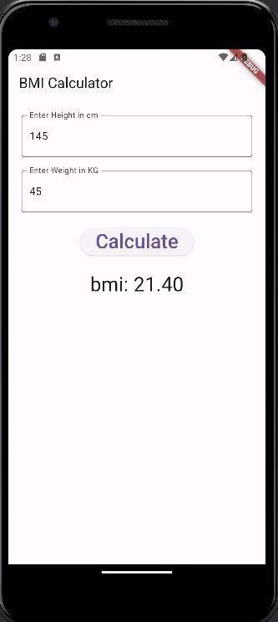
Example App 1
In this example, you will build an BMI Calculator that will accept two input numbers and calculate BMI value.

Slide 10
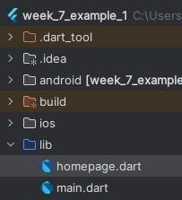
Example App 1
Create a new Flutter Project.
Create a new dart file named “homepage.dart”.

Slide 11
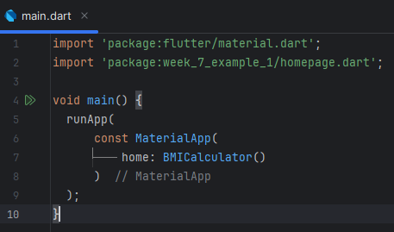
Example App 1
In the main.dart file, create a main function to kictstart the app running.

Slide 12
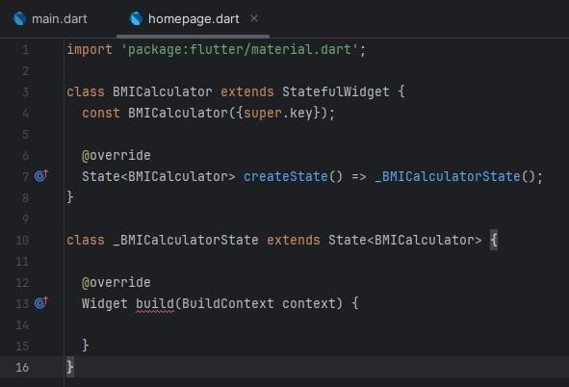
Example App 1
In the homepage.dart file, create a BMICalculator class that extends a StatefulWidget.
Create another private class named _BMICalculatorState that will extends a State class.

Slide 13
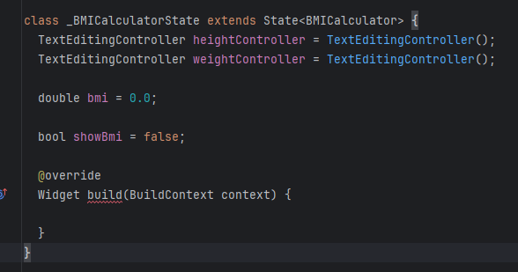
Example App 1
Create two TextEditingController for height and weight text fields.
Create a variable to store BMI value and another Boolean variable to set the visibility status of BMI value.

Slide 14
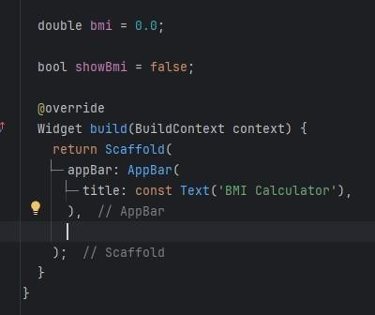
Example App 1
In the build function, create an AppBar within the Scaffold layout widget.

Slide 15
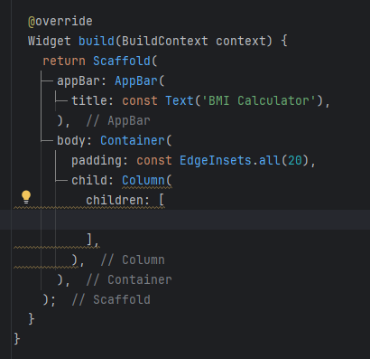
Example App 1
In the Scaffold body, create a Padding widget that wrap around a Column layout widget.

Slide 16
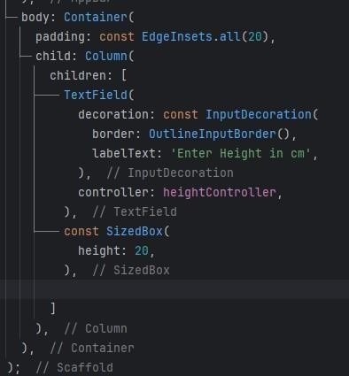

Example App 1
Add a TextField widget to the Column.
Set the heightController to the TextField.

Slide 17
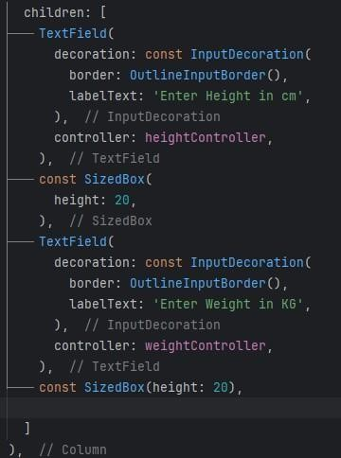

Example App 1
Create another TextField button.
Set the weightController to the TextField.

Slide 18
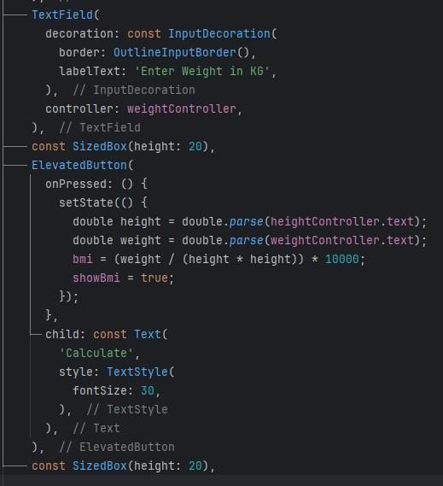
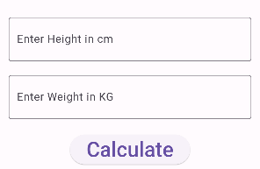
Example App 1
Create an ElevatedButton widget.
In the onPressed function, invoke the setState() function to set the height, weight, bmi and showBmi value based on user input.

Slide 19
Connect the TextFields to the controllers

Slide 20
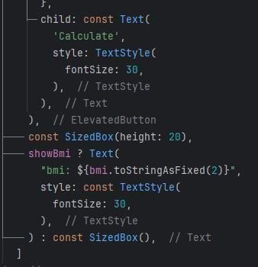
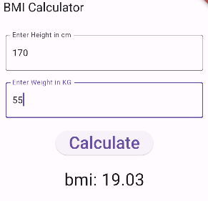
Example App 1
Create a Text widget to display BMI value.
If showBmi equal to true, it will generate a text to display the bmi value.

Slide 21
See you next class

